Slide 1
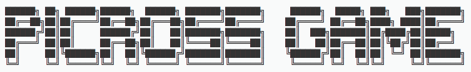
What’s the Picross Game ?

Slide 2
Summary
Presentation of the game
The Game Menu
Game design
Get SuperPower
Sharing tasks
Software, Website & equipment used

Slide 3
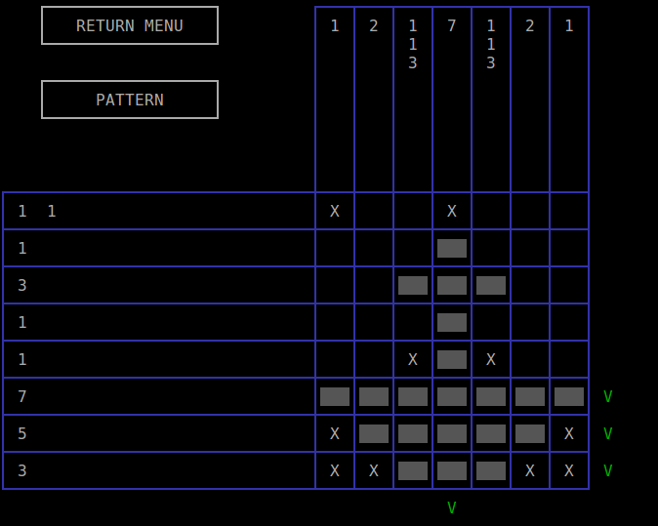
Presentation of the game
PICROSS GAME is a board game with variable size formed by boxes to fill.
His goal is to make appear a hidden picture by coloring the boxes corresponding to the numbers to the left and above the game grid.
We have invented many pictures that you can discover during tour experience in the game.
You can also challenge yourself with the Random Mode with the size of your choice.
PICTURE_MODE

Slide 4
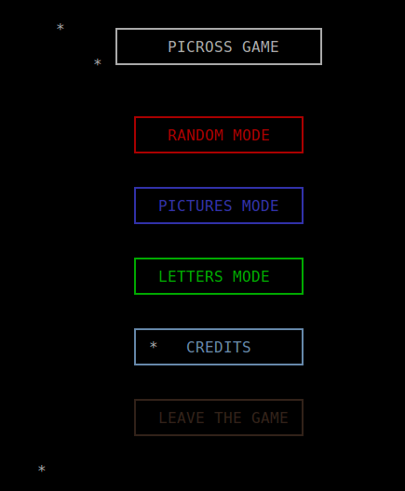
The Game Menu
The game menu is composed of 3 different game modes.
RANDOM MODE : Play mode for playing on a PICROSS grid at random boxes of a desired size between 1x1 and infinite x infinite. it still recommended to opt for a grid of minimum size 4x4 and maximum size 17x25 for a screen size 15 inches for example.
PICTURES / LETTERS MODE : Play mode for playing on a PICROSS grid of predefined size. A hidden image to discover for each level proposed!
MAIN MENU

Slide 5

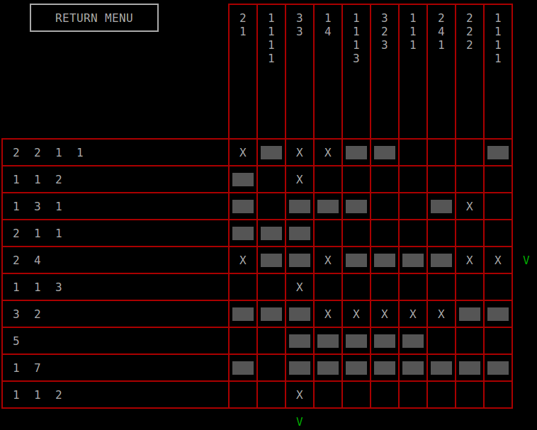
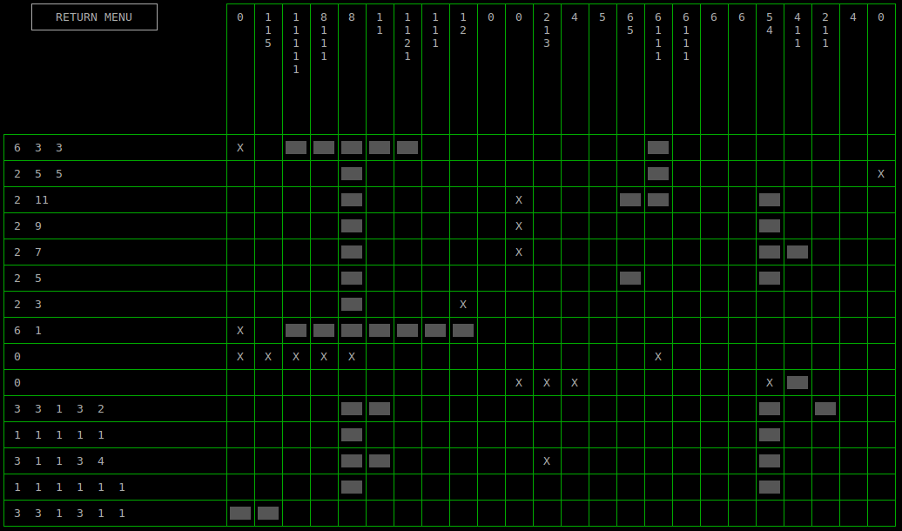
Game design
PICROSS design allow players to enter in a snowy atmosphere.
The color is important to know the level of the game mode.
Red = HARD | Blue = Medium | Green = Easy
Stars in the Menu
Each color corresponds to a game mode.
Red for RANDOM MODE | Blue for PICTURE MODE | Green for LETTER MODE
RANDOM_MODE
LETTER_MODE

Slide 6
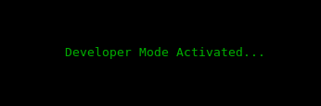
Get SuperPower
What’s the SuperPower ?
It allows you to get the developer status and then, you can cheat !
When you are playing at PICROSS GAME as a normal player, you don’t have any SuperPower.
If you have the SuperPower, you should be able to see the pattern while you’re solving the puzzle.

Slide 7
Sharing tasks
Thierry (Kyu) | Nimrod
Realization of the PICROSS game grid : RANDOM_MODE/SECRET_MODE/PICTURES_MODE/LETTERS_MODE Realization of design : SNOWFLAKES/COLOR/WELCOME/CONGRATULATION Realization of music & sound : MENU THEME/CLICK SOUND EFFECT/OPENING THEME/ENDING THEME/RANDOM THEME/PICTURES THEME/LETTERS THEME Realization of CREDITS Comment in the code | Realization of the PICROSS game menu : BOX/CLICK AREA Realization of ¾ of the pictures : for PICTURES_MODE/LETTERS_MODE Realization of music & sound : SECRET THEME/CREDITS THEME Realization of CREDITS Comment in the code

Slide 8
Software, Website & equipment used
C language NCURSES Libraries YouTube YAMAHA Piano P-255 Linux – Ubuntu NCURSES Programming HOWTO (Website)

